Slide 1
Data Science Mentoring
Week 3 | Image Scrapping Techniques

Slide 2
Content
Presentation what everyone has learn
Image Extraction Technique
Assignments

Slide 3
Presentation Time

Slide 4



Data Collection Approaches
Coding
Website Extension
Buying

Slide 5
Extension
Webscraper tool: https://webscraper.io/ : https://youtu.be/OuH8u2auvzY
Tab Save: https://chrome.google.com/webstore/de...
https://youtu.be/sPUzhKNZmho :
https://youtu.be/Q9kKG8nxfec Beautiful Soup
Sellenium : https://youtu.be/NBuED2PivbY
Ortoparse : https://youtu.be/cb2F2APJcU8

Slide 6
Thanks

Slide 7

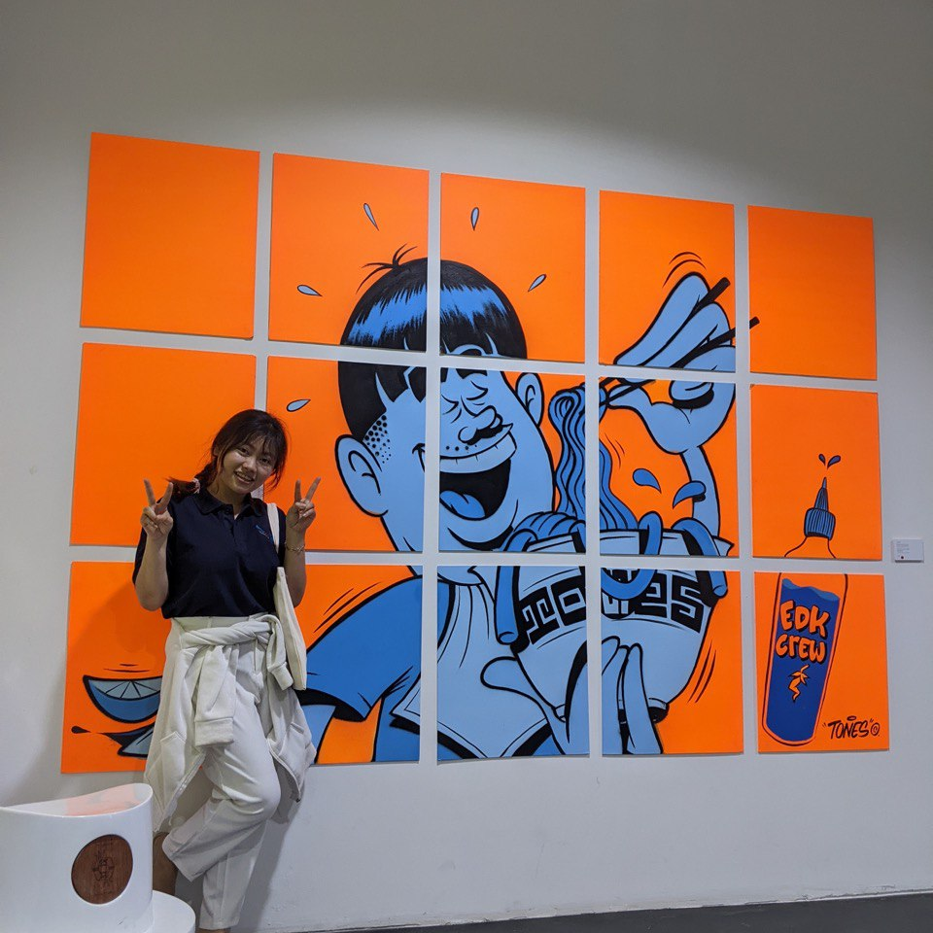
Hello!
I am Manuth
A Digital Data Scientist At ABA Bank
Business Analytic At Shunhe Logistic.CoTD
AI Research Intern At CADT
Project Owner at E-Tool Robotic and IOT Store

Slide 8






Experienced on Projects
Crop Recommendation
OCR On Scanned-Document-Image
Agricultural Sector
Education Sector
Customer Spending Behaviour Analytic
Customer Segmentation
Logistic Sector
Financial Sector
CV and JD Matching
Credit Loan Risk Recommendation
Financial Sector
Financial Sector

Slide 9
1.
About Mentorship Program
Let’s start with the first set of slides

Slide 10



Our process is easy
Work
Learn
Real-Time Project
Basic python
Data Science Pipeline
Practice
Homework
Discussion
Quiz

Slide 11
Mentoring Process
Advising
Initializing the roadmap
Providing Learning Resources
Knowledge Sharing
Checking-up
Progress Checking
Hosting Discussion Workshop
Progress Checking
Guiding
Designing state of the art
Being with you in all processes

Slide 12
Timeline
Mentoring Program Starts
Basic of analytic
Deployment to production
Analyzation and modeling
White is the color of milk and fresh snow
APR
MAY
JUN
JUL
AUG
……
Fundermental of Python
And Mathematic
Algorithm Selection and Model Building and testing
Project Initialization and implementation
Evaluation and Presentation

Slide 13
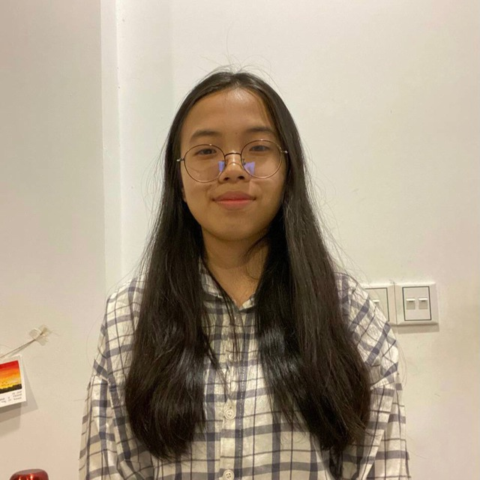
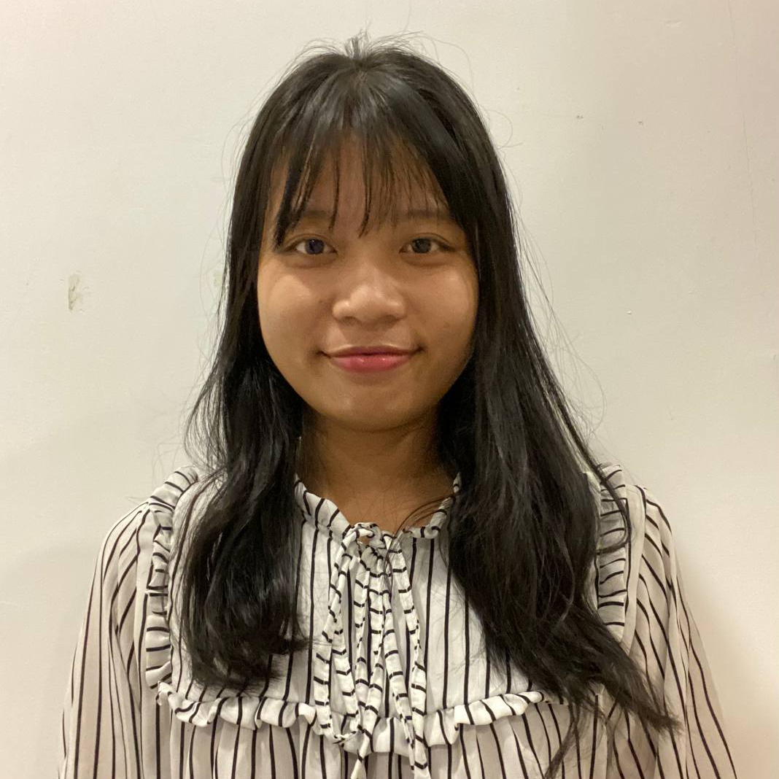
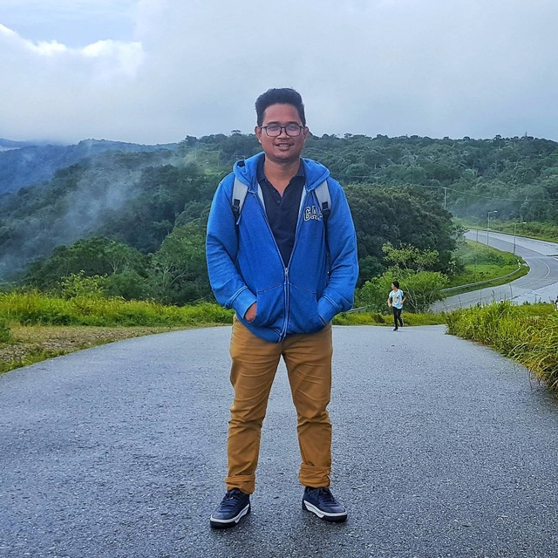
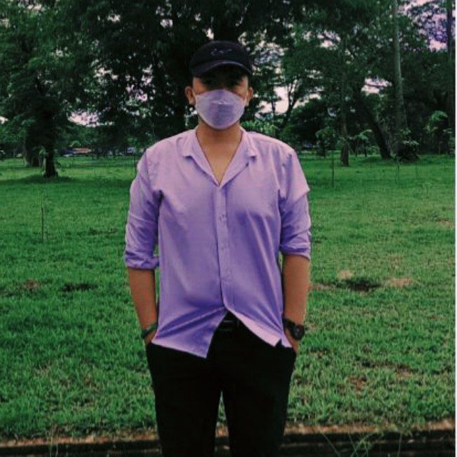
Speakers
Ms. Reasey Sereineath Software Engineer Student
Suy Chakriya Software Engineer Student
Mr. Sreang Rathnak AI Team Lead
Data Mining , AI And Cloud Computing
Mr. Sok Hong Business Analytic
Kouch Mengly Group
Topic : How to make a good storyboard as the storytelling ?
Date : 23.April.2023
Time : 10:00 AM – 11: 30 AM
More

Slide 14

By the end of the mentorship program
Better Understanding
Of what data science is and the basic of python programming
Clear
With the roadmap and the step to implement on most of the data science project .
Know varieties of approaches
And it’s usage for implementing on the proejct and what to consider when working on the data science project .
Getting-New Concept
Of implementing on various recommendation system
Networking
With the expertise people with data science domain
Credit-Building
You will get a certificate of recognition after successfully completing the project

Slide 15

You Like IT or NOT ?

Slide 16
Learning is a journey that often presents us with obstacles and mental challenges, but with unity and perseverance, we can overcome them and reach our destination as a team.

